Slide 1
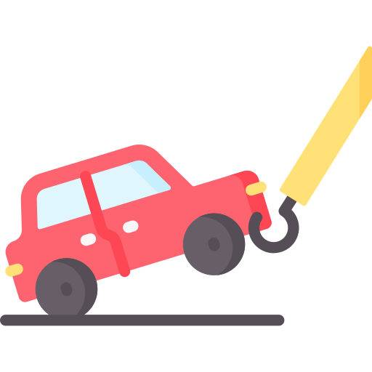

Tow Mater
First review
+ Martin Chéliz
+ Laura Mendes
+ Samantha Gorrin
+ Alexis Pierre Dit Lambert
+ Imane El Khamlichi
+ Léonie Hatte
Notes:
Imane

Slide 2




Table of content
The final product
Release vision
The first release
Demonstration
Tests
Sprint evaluation
Next Sprint
Notes:
Imane

Slide 3
Part 1 : The product
Notes:
Imane

Slide 4
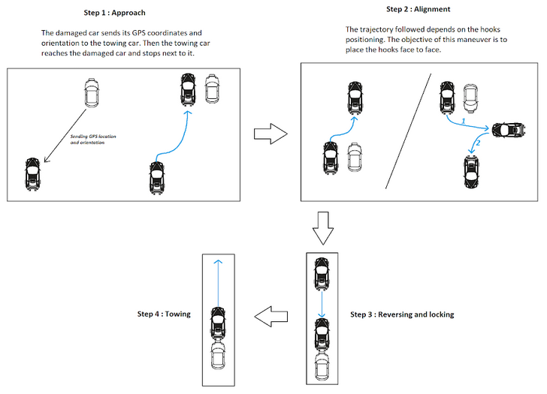
The final product
Step 1: The damaged car sends its GPS coordinates and orientation to the towing car. Then, the towing car reaches the damaged car and stops next to it
Step 2: The followed trajectory depends on the hooks’ position. The objective of this maneuver is to place the hooks face to face
Step 3: Reversing and locking
Step 4: Towing
Performing the
alignment maneuver and towing the car
Detecting and
avoiding obstacles
Communicating with damaged car
Reaching the
damaged car
Notes:
Imane

Slide 5
Release vision
Reverses in a straight line
Locks the hook
Tows in a straight line
Identifies the hook
Detects large obstacles
Sprint 4
Sprint 2 (No U-turn)
Avoids fixed obstacles during alignment maneuver
The vehicles communicate
Aligns itself with the damaged car
Detects small obstacles
U-turn
Identifies moving obstacles
Reaches the damaged car
Performs the alignment
Locks the hook
Tows in a straight line
Avoids fixed obstacles
Stops when moving obstacles
Sprint 1
Sprint 3 (with U-turn)
Sprint 5
Notes:
Martin

Slide 6
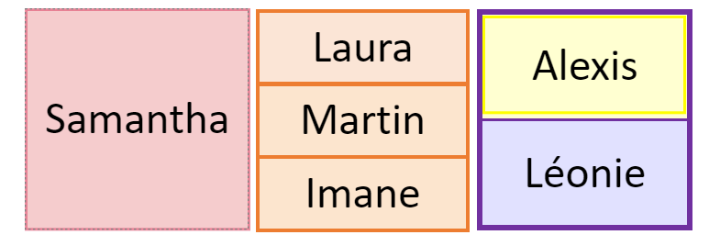
First release
18/10
15/11
Time
Higher Priority
Locking the towing hook
Lower Priority
Detecting the hook of the broken car
Detecting a large obstacle then stop
Moving backwards in a straight line to place the tow hook
Towing the car on a straight line
Notes:
Martin

Slide 7
Part 2 : The demo
Notes:
Martin

Slide 8
Demonstration
The towing car can follow 2m in a straight line.
The towing car can keep a constant speed of 0,8m/s.
The towing car stops at a minimum distance of 50cm from a big obstacle.
The towing car detects the purple colour on the damaged car 5s after detecting it.
The towing car reduces its speed of 50% when it detects an obstacle.
The hook can be done at a distance interval from 10cm to 20cm.
The towing car can tow on a minimum 2m straight line.
Notes:
Laura
8

Slide 9
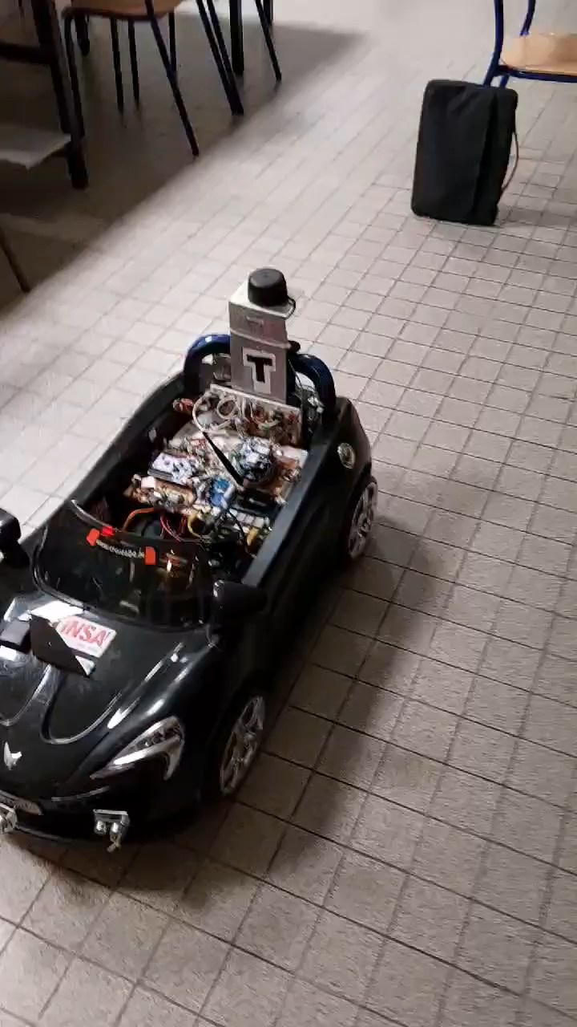
Demonstration (1/3)
Moving backwards in a straight line to place the tow hook
Detecting a large obstacle then stop
Notes:
Alexis : In terms of performance, constant speed, stop at a safe distance

Slide 10
Demonstration (2/3)
Detecting the hook of the broken car
Notes:
Alexis

Slide 11
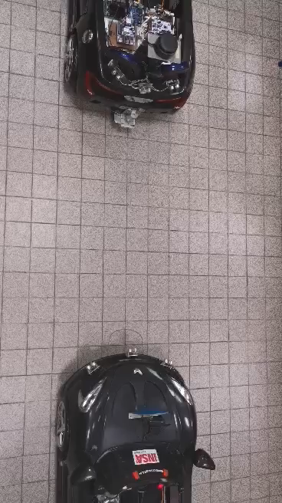
Demonstration (3/3)
Locking the towing hook
Towing the car on a straight line
Notes:
Alexis : In a perfect world we would be Good in terms of performance in this section. But we have serious limitations in this section. First the tow vehicle is should be powerfull enough to pull the damaged car, but the low grip of the Wheels skid, to solve this problem we could improve the adherance of them but this enters more in a mechanical problem so there was not too much that we could do. Plus the damaged car because the rear wheels are locked. This adds friction to the system which doesn’t help to the not very powerfull tow car.

Slide 12
Part 3 : The analysis
Notes:
Léonie

Slide 13
Tests
Stationary car
Locking the towing hook
Manual publication on the ROS topic
Trials with different smooth surfaces under the wheels
Towing the car on a straight line
Grit and engine break
Manual towing command with the joystick
The two cars are aligned according to the grid of the tiles
Moving backwards in a straight line to place the tow hook
Speed of -0.8 m/s
Drift of 2 cm/m Maneuver in a radius of 2 m so less than 4 cm drift
Notes:
Léonie
13

Slide 14
Tests
Obstacle bigger than 30 cm
Detecting a large obstacle then stop
Stops 50 cm +/- 5 cm away from obstacle
Stops in less than 5s
Maximum 2 cm wheel slippage
Detects several shades of the color we want: tests withs purple and red
Detecting the hook of the broken car
Detects the hook 5s after detecting the obstacle
Notes:
Léonie
14

Slide 15

Sprint evaluation
The towing car can follow 2m in a straight line.
The towing car can keep a constant speed of 0,8m/s.
Done
Done
The towing car stops at a minimum distance of 50cm from a big obstacle.
The towing car detects the purple colour on the damaged car 5s after detecting it.
Done
The towing car reduces its speed of 50% when it detects an obstacle.
The hook can be done at a distance interval from 10cm to 20cm.
Done
Done
The towing car can tow on a minimum 2m straight line.
Notes:
Laura
15

Slide 16
Part 4 : The plan
Notes:
Samantha: I’m going to talk about what we’re going to do next on second sprint.

Slide 17
Next sprint
Detecting the hook of the broken car
Manoeuvring to line up with the damaged vehicle
Add a camera to the back of the car
Detect the car hook by camera image
Define the trajectory
Implement the trajectory
Higher Priority
Towing the car on a straight line
Lower Priority
Add a smooth material under the wheels
Put the wheels in the axis manually
Detecting a small obstacle
Notes:
Samantha: On first sprint, we couldn't finish one user story; So, we want to

Slide 18
Next Sprint
Sprint 2
The towing car does not deviate more than 5cm from a predefined trajectory.
The towing car stops at a minimum distance of 50cm from a small obstacle.
The towing car detects the purple colour on the damaged car 5s after detecting it.
Notes:
Samantha
18

Slide 19
Tests
Stationary car
Detecting the hook
Detecting a shape + colour
Manual towing command with the joystick
Towing the car on a straight line
Trials with different smooth surfaces under the wheels
Towing on 5 m
Notes:
Laura
19

Slide 20
Tests
Predefined trajectory
Maneuver to line up with the damaged car
Speed of -0.8 m/s
Drift of less than 4 cm/m
Obstacle smaller than 30 cm
Detecting a small obstacle then stop
Stops 50 cm +/- 5 cm away from obstacle
Stops in less than 5s
Maximum 2 cm wheel slippage
Notes:
Laura
20

Slide 21

Questions ?
Notes:
Laura

